Slide 1
Year 2 – Summer Block 1 – Position and Direction – Describing Movement
About This Resource:
This PowerPoint has been designed to support your teaching of this small step. It includes a starter activity and an example of each question from the Varied Fluency and Reasoning and Problem Solving resources also provided in this pack. You can choose to work through all examples provided or a selection of them depending on the needs of your class.
National Curriculum Objectives:
Mathematics Year 2: (2P2) Use mathematical vocabulary to describe position, direction and movement, including movement in a straight line and distinguishing between rotation as a turn and in terms of right angles for quarter, half and three-quarter turns (clockwise and anticlockwise)
More Year 2 Position and Direction resources.
Did you like this resource? Don’t forget to review it on our website.
© Classroom Secrets Limited 2019

Slide 2
Year 2 – Summer Block 1 – Position and Direction
Step 1: Describing Movement
© Classroom Secrets Limited 2019

Slide 3
Introduction
Follow the instructions below.
Why have your answers changed?
Stand so that you are facing the window.
What’s to your left? What’s to your right?
What’s in front of you? What’s behind you?
Now turn so that you are facing the door.
What’s to your left? What’s to your right?
What’s in front of you? What’s behind you?
© Classroom Secrets Limited 2019

Slide 4
Introduction
Follow the instructions below.
Why have your answers changed? The answers have changed because the direction you are facing has changed.
Stand so that you are facing the window.
What’s to your left? What’s to your right?
What’s in front of you? What’s behind you?
Now turn so that you are facing the door.
What’s to your left? What’s to your right?
What’s in front of you? What’s behind you?
© Classroom Secrets Limited 2019

Slide 5
Varied Fluency 1
In which direction is the ladybird moving?
© Classroom Secrets Limited 2019

Slide 6
Varied Fluency 1
In which direction is the ladybird moving? The ladybird is moving to the left.
© Classroom Secrets Limited 2019

Slide 7
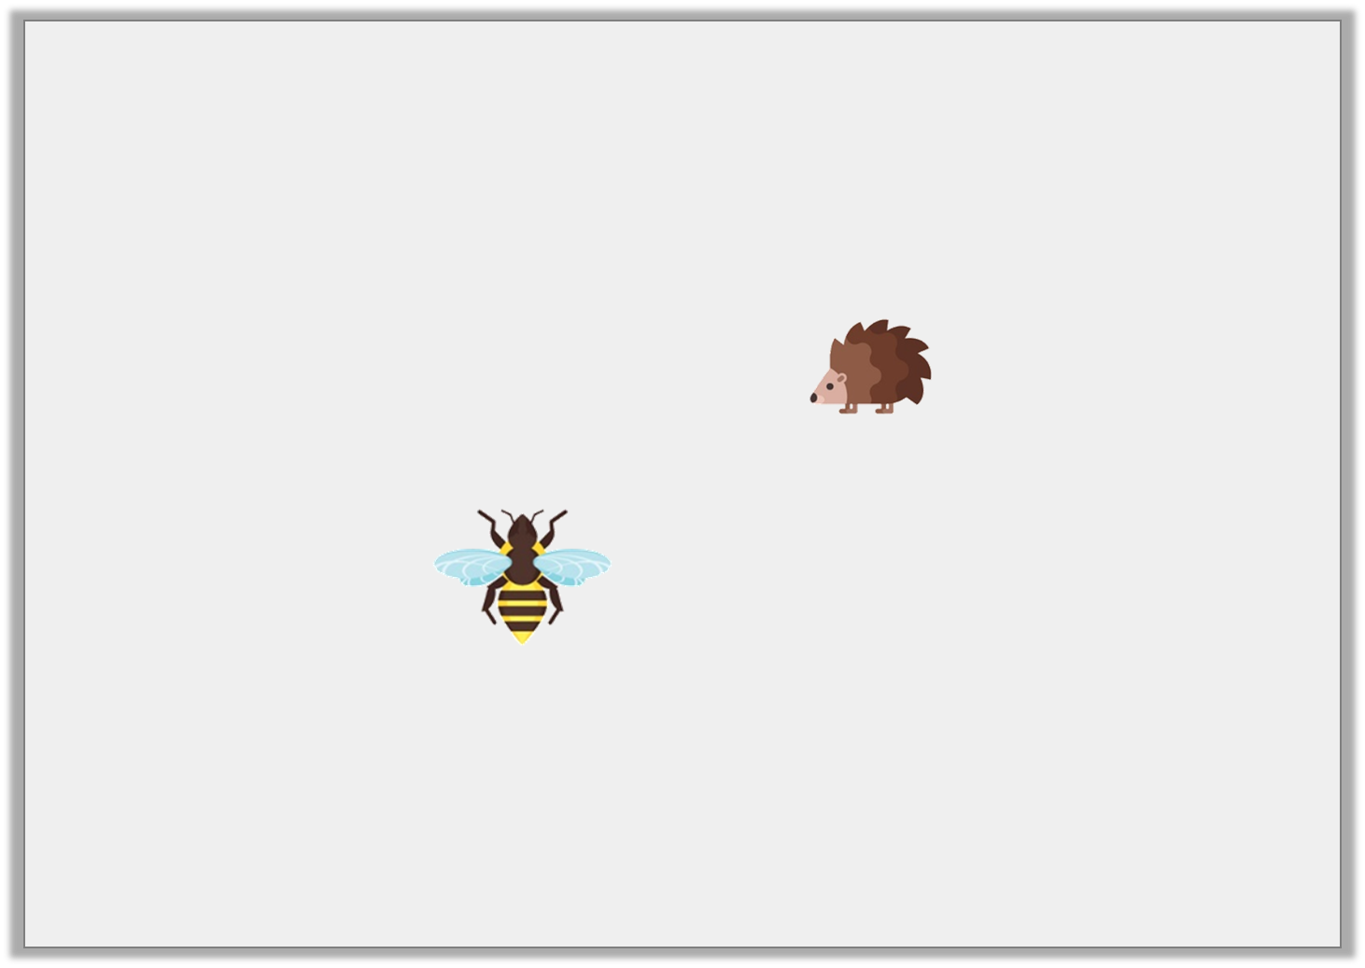
Varied Fluency 2
In which direction is each creature moving?
© Classroom Secrets Limited 2019

Slide 8
Varied Fluency 2
In which direction is each creature moving?
The wasp is moving forwards, the hedgehog is moving to the left.
© Classroom Secrets Limited 2019

Slide 9
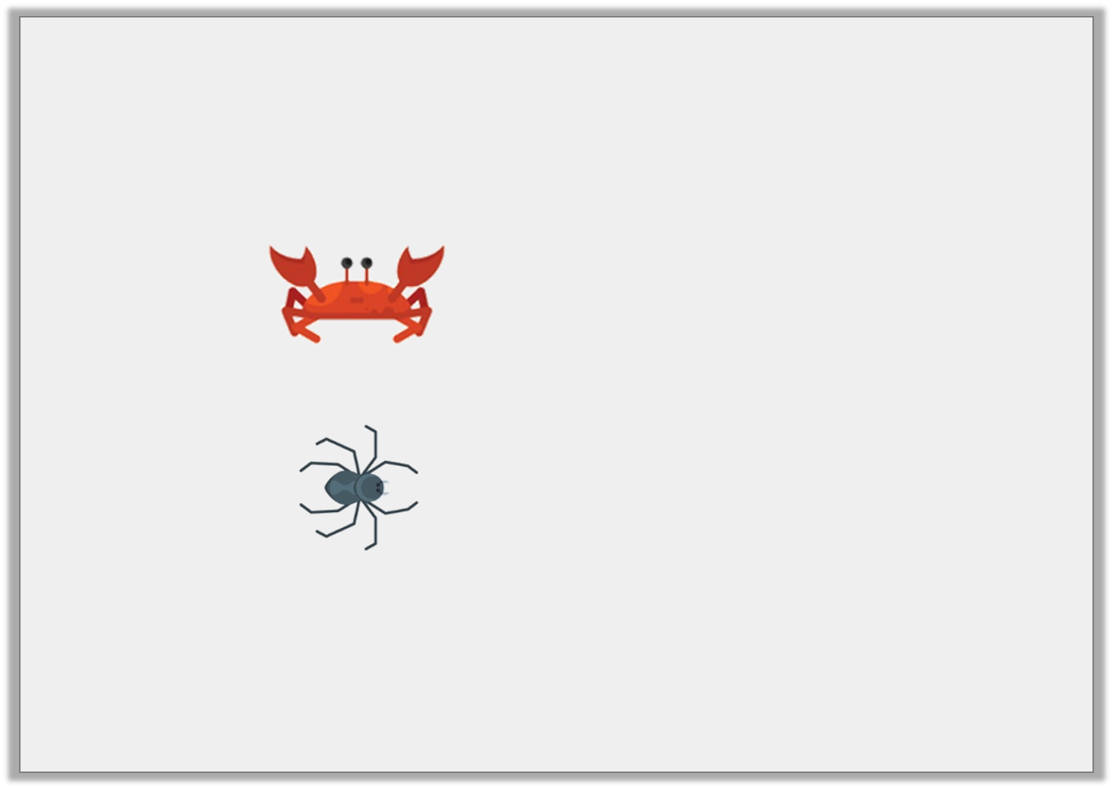
Varied Fluency 3
Say which creature is moving to the left.
© Classroom Secrets Limited 2019

Slide 10
Varied Fluency 3
Circle the creature which is moving to the left.
The crab (the spider is moving forwards).
© Classroom Secrets Limited 2019

Slide 11
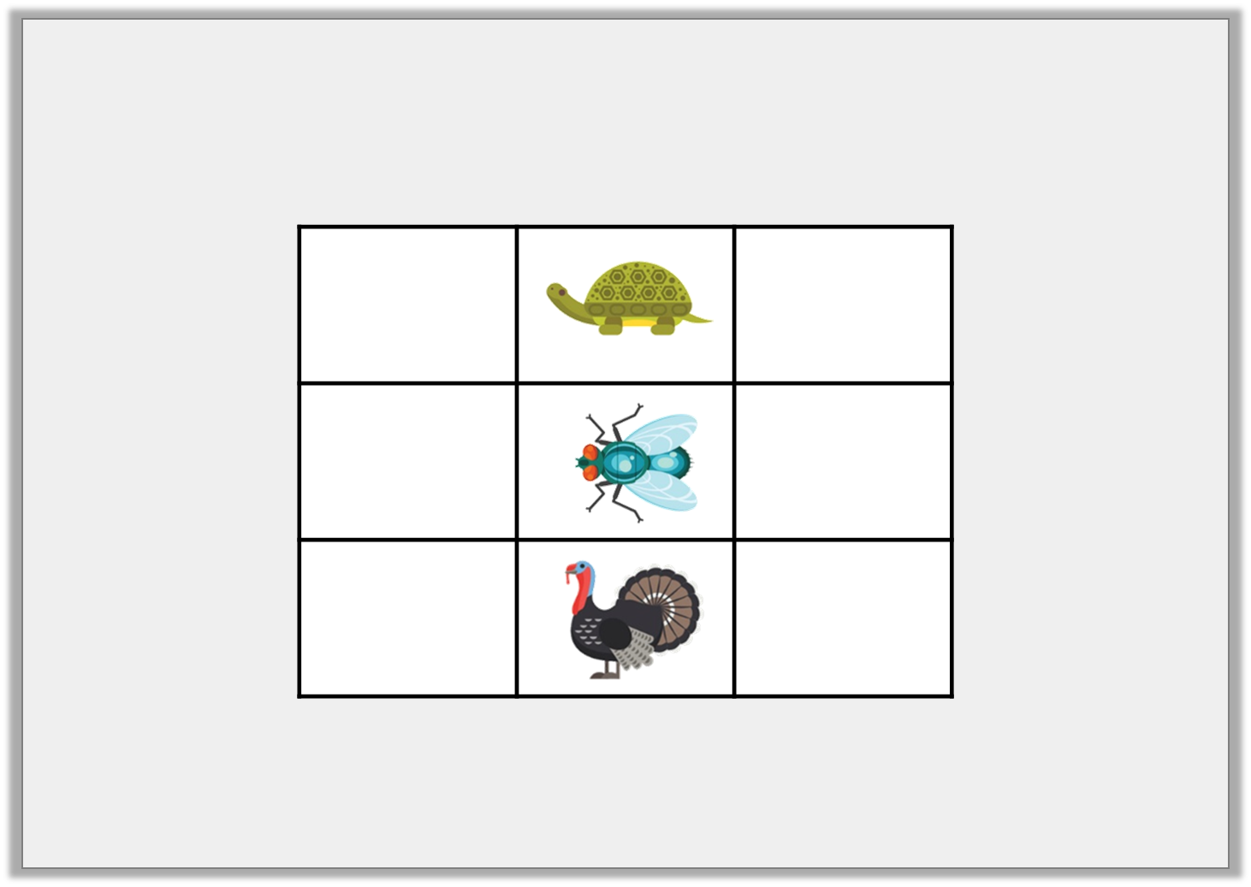
Varied Fluency 4
True or false? The bug is to the right of the turkey.
© Classroom Secrets Limited 2019

Slide 12
Varied Fluency 4
True or false? The bug is to the right of the turkey.
True
© Classroom Secrets Limited 2019

Slide 13
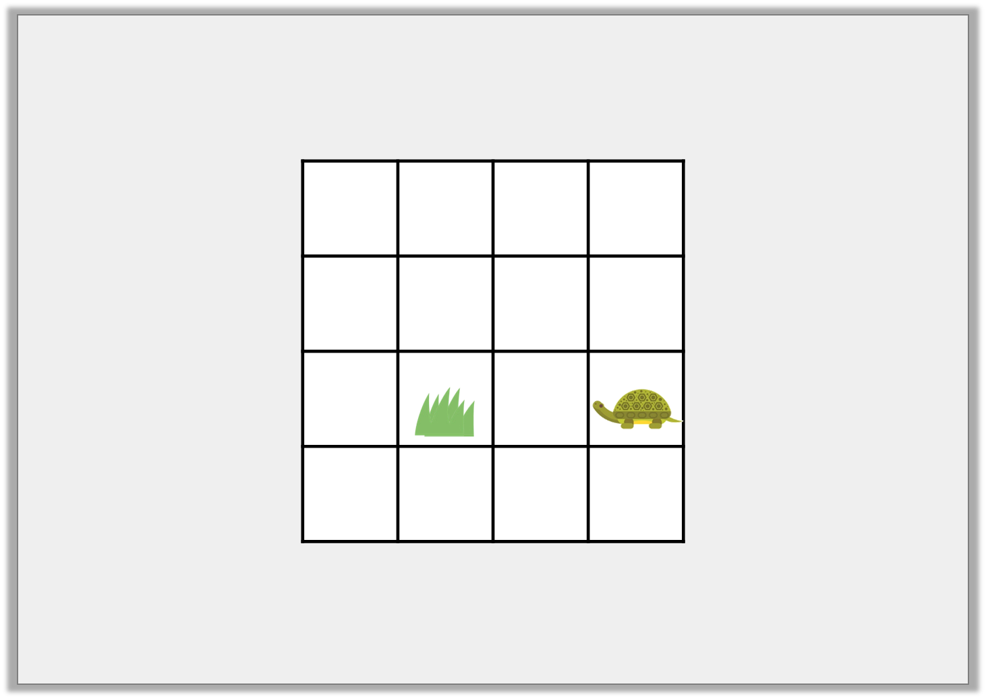
Reasoning 1
Ria thinks that if the turtle moves 2 squares to the left, it will find the grass.
Is she correct? Explain how you know.
© Classroom Secrets Limited 2019

Slide 14
Reasoning 1
Ria thinks that if the turtle moves 2 squares to the left, it will find the grass.
Is she correct? Explain how you know. Ria is not correct because…
© Classroom Secrets Limited 2019

Slide 15
Reasoning 1
Ria thinks that if the turtle moves 2 squares to the left, it will find the grass.
Is she correct? Explain how you know. Ria is not correct because the turtle must move two squares forwards.
© Classroom Secrets Limited 2019

Slide 16
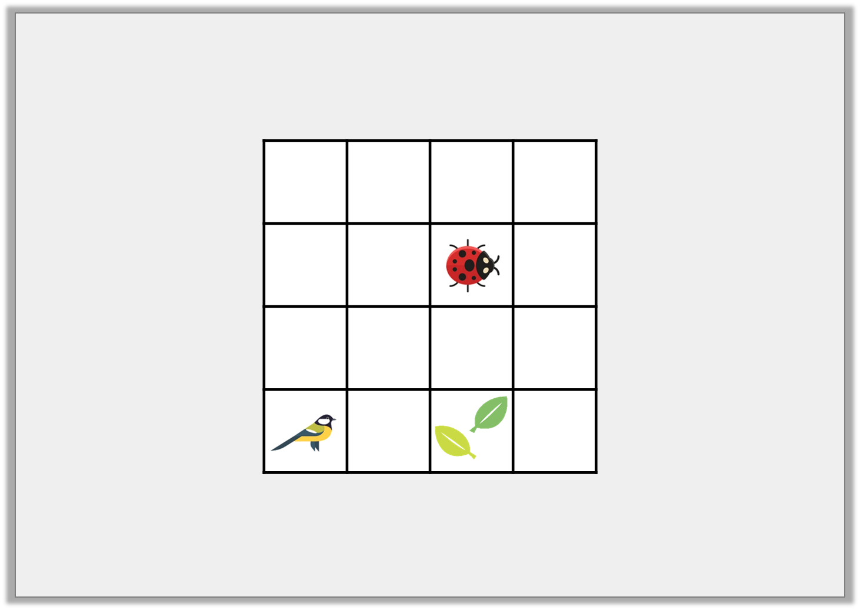
Problem Solving 1
Write statements using forwards, backwards, left and right to describe how each creature can get to the leaves.
© Classroom Secrets Limited 2019

Slide 17
Problem Solving 1
Write statements using forwards, backwards, left and right to describe how each creature can get to the leaves.
Various possible answers, for example:
The ladybird moves two squares to the right and the bird moves two squares forwards.
© Classroom Secrets Limited 2019

Slide 18
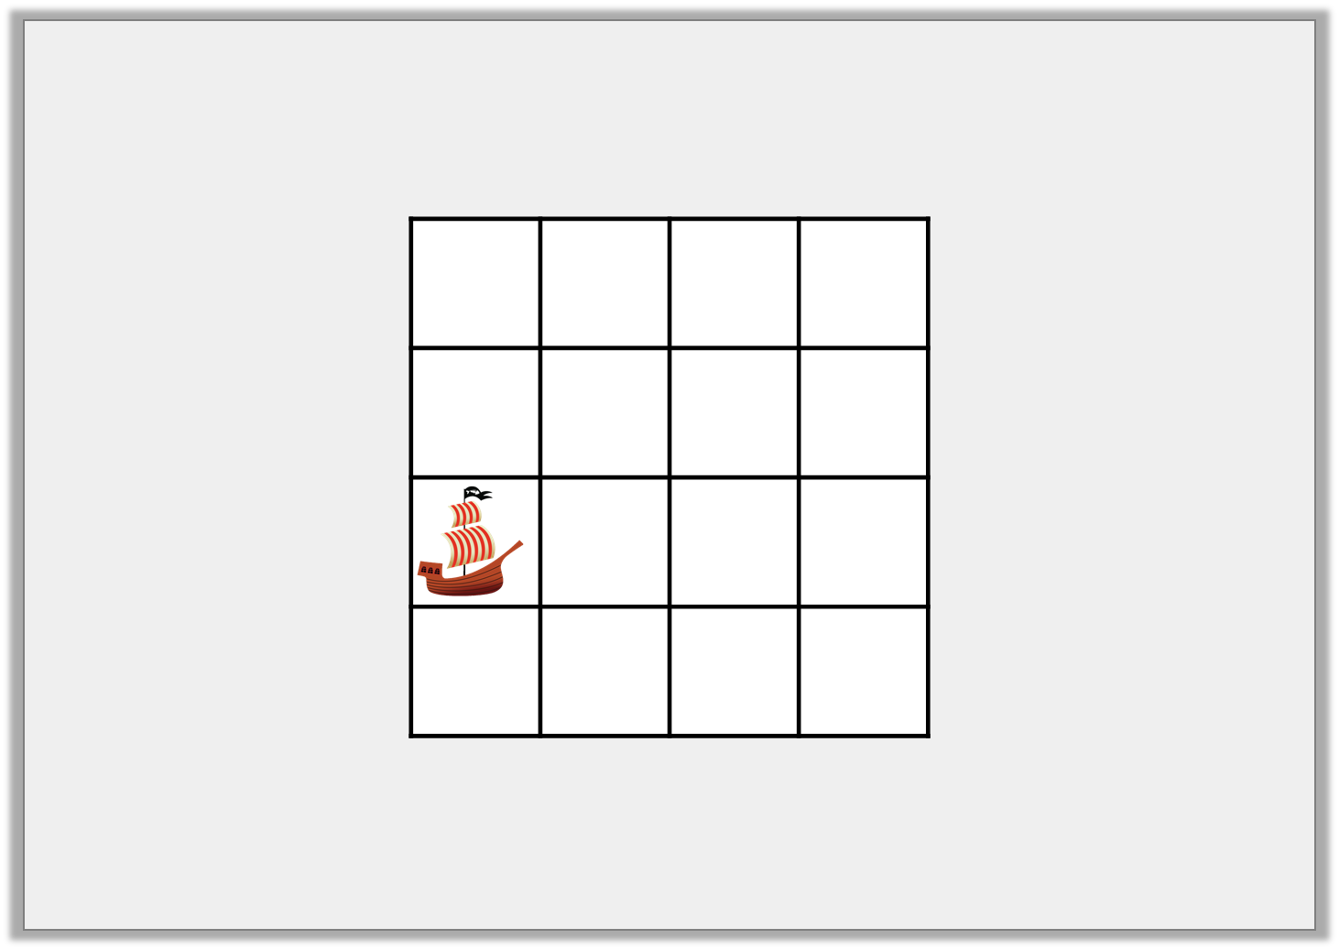
Problem Solving 2
The treasure is buried 2 squares left of the ship. Where is the treasure buried?
© Classroom Secrets Limited 2019

Slide 19
Problem Solving 2
The treasure is buried 2 squares left of the ship. Where is the treasure buried?
© Classroom Secrets Limited 2019

