Slide 1
Science - Year 3
Animals incl. Humans – Block 3AH
Keeping Healthy
Session 2
Task PowerPoint
© Original resource copyright Hamilton Trust, who give permission for it to be adapted as wished by individual users.
We refer you to our warning, at the foot of the block overview, about links to other websites.

Slide 2
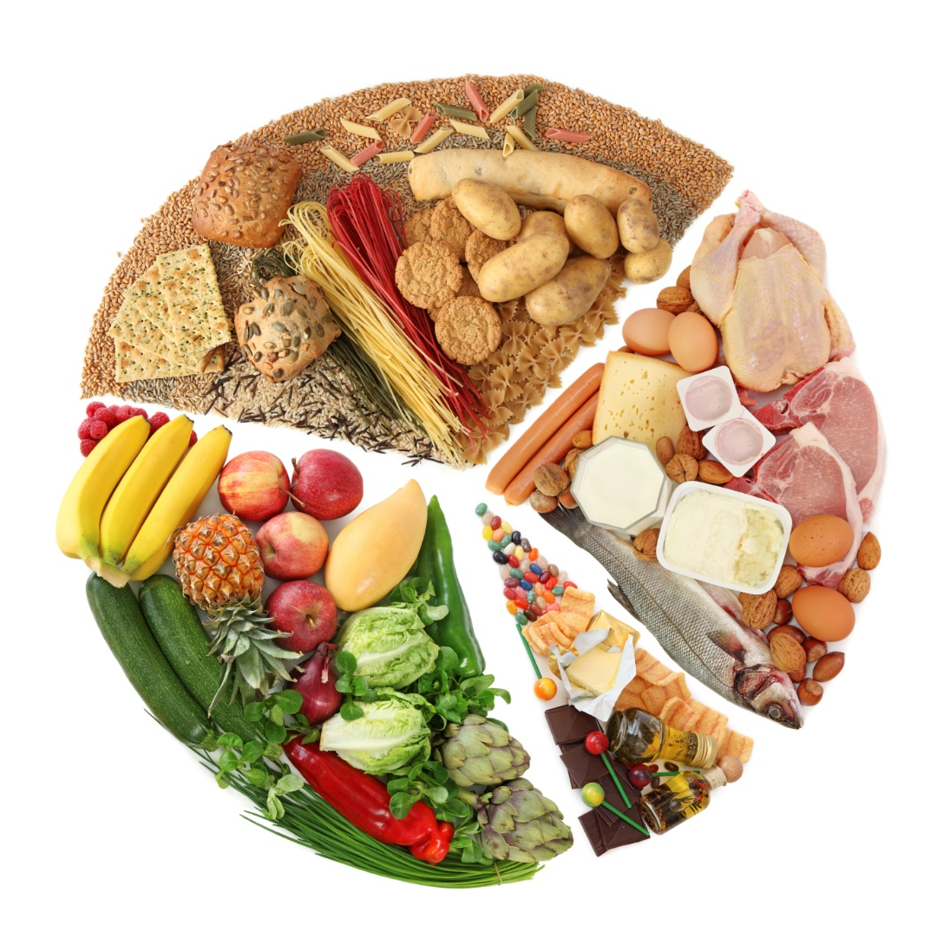
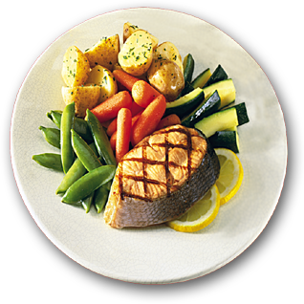
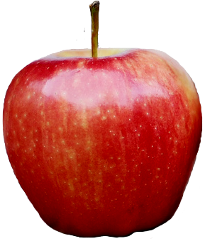
A balanced diet is made of many meals. Not every meal needs to have the exact recommended proportions of each food group, if overall each day you get the balance right.
Which food groups can you see in this meal?
Which groups are missing?
Remember sugars and fats are treat foods so missing them out of a meal will not hurt!

Slide 3
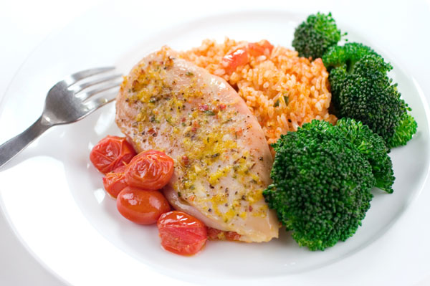
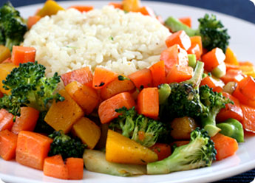
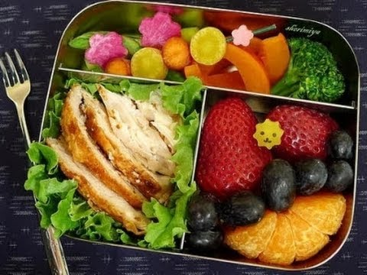
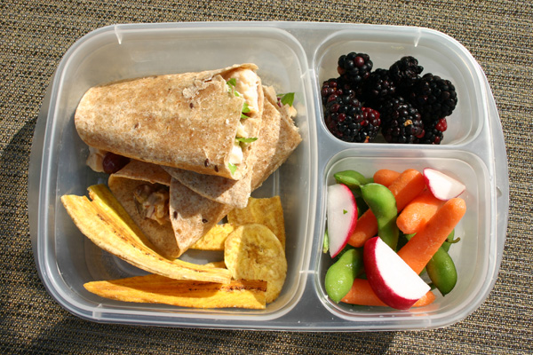
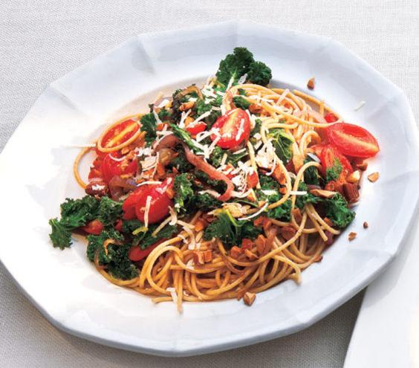
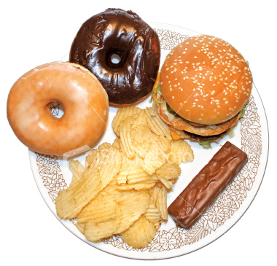
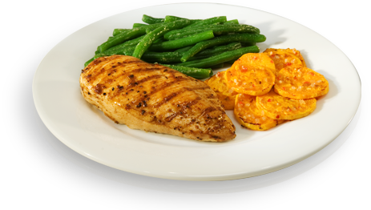
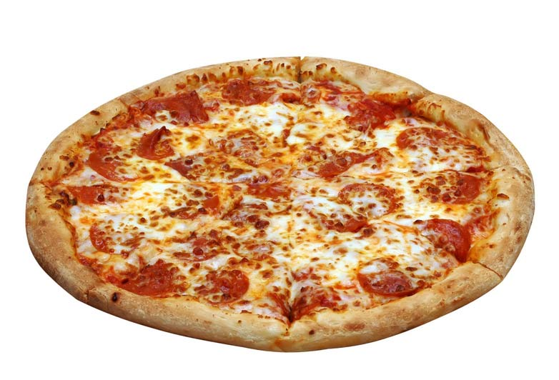
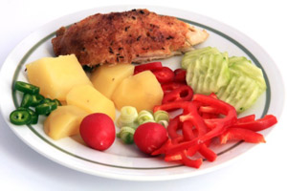
Which of these meals could form part of a healthy balanced diet?
Which could not? Why?

Slide 4
Many of the meals you enjoy are probably balanced and healthy
Name the food groups one at a time
A
B
Protein
For building strong muscles, for growth and repair after injury
Carbohydrate
For steady energy
C
Vegetables
For fibre and vitamins

Slide 5
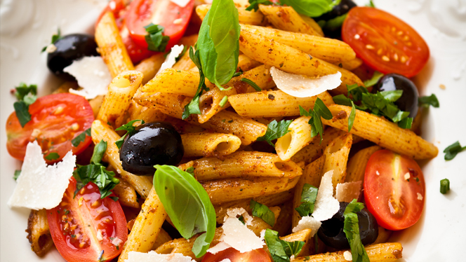
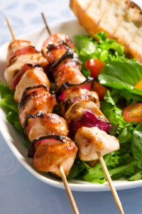
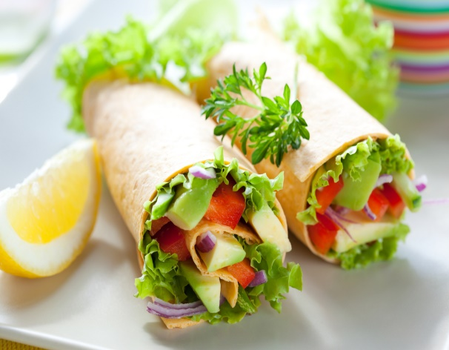
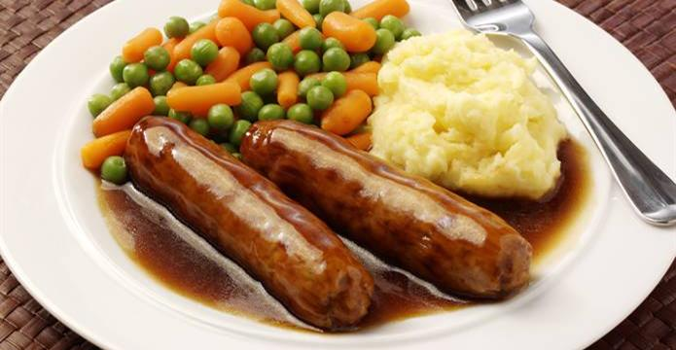
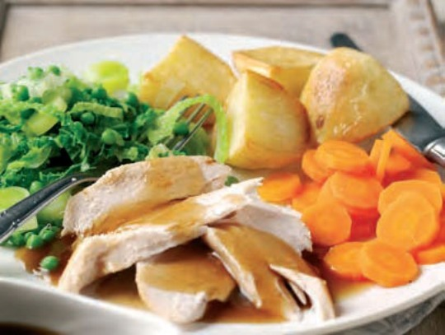
Your task is to work with a partner to create a model of a balanced main course meal to give your client some healthy ideas
Choose a source of protein
Choose a carbohydrate
Choose plenty of vegetables, fruit or salad

Slide 6
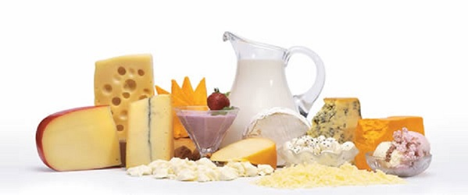
You may have some dairy in the form of cheese, cream in a sauce or milk in the mashed potato but do not worry if you don’t. Remember: a balanced meal is only part of a balanced diet. You could have yogurt or milk for breakfast or as part of your packed lunch.

Slide 7
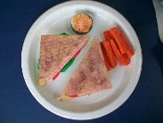
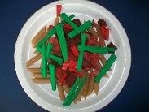
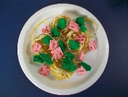
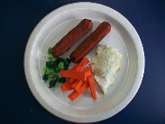
Here are some examples of the type of model meal you will create to give your client some ideas for a healthy, balanced diet
Cheese, ham or tuna Sandwich made with wholemeal bread and salad. Carrot sticks and hummus dip.
Beef or Quorn bolognaise on wholegrain pasta with red peppers and green beans
Tagliatelle in a light cheese sauce with onions, ham and broccoli
Sausages, mashed potato, carrot batons and peas

Slide 8
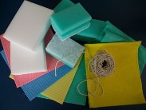
You can choose whatever main course meal you like so long as it has carbohydrate, protein and plenty of vegetables or salad
Washing up sponges have a rougher foam texture when you tear them so they are good for more textured foods, e.g. broccoli
Modelling materials
Sponge foam can be cut into any shape
Washing up cloths are floppy so they are good for greens and salad leaves
Sponge cloths are flat sheets of foam which is great for slices, e.g. bread, cheese, meat
String makes great noodles and spaghetti

Slide 9
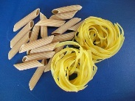
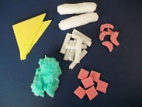
Apart from spaghetti, pasta can be itself on your plate. Remember, whole-wheat is always more healthy. It has more fibre and releases its energy slowly so you feel full for longer and don’t snack between meals.
Here, sponge foam and sponge cloths have been cut and shaped, using scissors, into food like bread, sausages, carrot sticks, mash, ham and prawns.

Slide 10
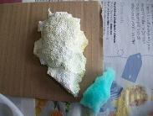
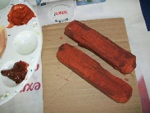
Here the green washing up sponge has been torn into a rough heap and painted white and cream to look like mashed potato or rice
The sausages look more realistic because they have been painted in 2 shades of brown – a light brown all over and then some darker brown highlights

Slide 11
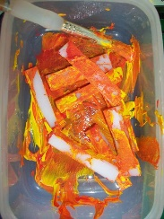
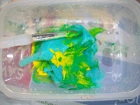
It is very quick and clean to paint lots of little shapes the same colour. Use a small plastic tub. Put your shapes in and a small amount of the paint you want. Mix it thoroughly with a paintbrush.
Here a torn piece of dish cloth is being mixed with green and yellow to make lettuce for a salad.
Here yellow and red have been added to mix with the carrot sticks.

Slide 12
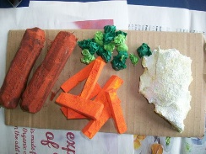
The peas have been made from small pieces of tissue paper that were smeared with a little glue and then screwed up. 2 colours of green make them look a bit more real.
As you and your partner create all the food needed for your balanced meal, place each item on a piece of card to dry (drying may take a day or two).
Once they are dry, you can glue them to your paper plate.

