Slide 1
Science - Year 3
Animals incl. Humans – Block 3AH
Keeping Healthy
Session 2
PowerPoint
© Original resource copyright Hamilton Trust, who give permission for it to be adapted as wished by individual users.
We refer you to our warning, at the foot of the block overview, about links to other websites.

Slide 2
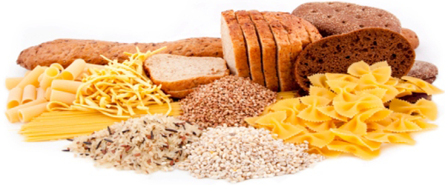
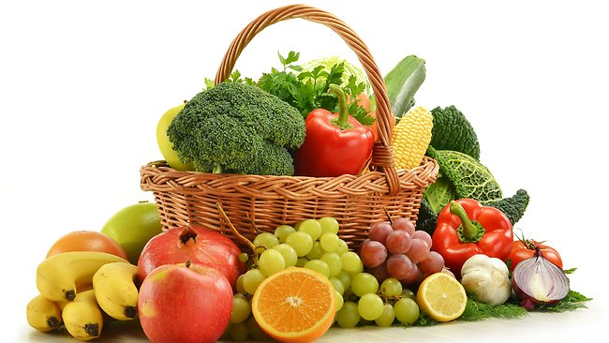
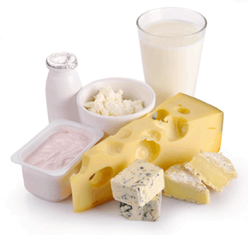
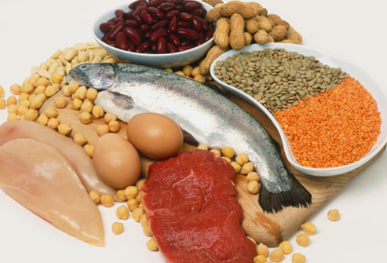
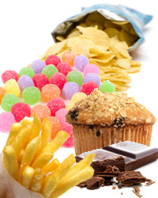
There are 5 main types of food in our diet.
Fruit and Vegetables
Carbohydrates
Dairy foods
Proteins
Sugars and Fats

Slide 3
Let’s find out a bit more about each type of food and what it does in our body

Slide 4
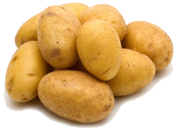
Carbohydrates
This food group includes bread, potatoes, rice, and pasta. They are the starchy foods that help us feel full after a meal.
Carbohydrates give us energy. They release their energy slowly so they keep us going a long time before we feel hungry again.

Slide 5
Fruit and Vegetables
We already know that we should eat plenty of these!
What is the minimum number of portions a day to be healthy?
5
But experts agree that ideally we should eat even more. Why?
Fruit and vegetables are packed with vitamins to keep our bodies working well and to help fight off colds and other illnesses. They are also full of fibre. What is fibre?
Fibre is the plant material that passes right through your body and out the other end! It gives bulk to your poo, keeping it soft and easy to pass. It keeps your bowel healthy.

Slide 6
Dairy Foods
Dairy foods are made from milk and include cheese, yogurt and cream. These foods are rich in a mineral called calcium which will give you strong bones and teeth.
Some people are not able to digest dairy foods or they can be allergic to them so there are many alternative products like this soya milk.
Some dairy foods like cream and cheese can contain a lot of fat.

Slide 7
Protein rich foods
These include meat, fish, eggs, nuts, beans, chickpeas and lentils.
Protein is an essential part of our diet as it is necessary for our bodies to grow and to repair themselves after an injury. Athletes need to eat plenty of protein to build up strong muscles.

Slide 8
Fats and Sugars
We already know we should limit the amount of sugar we eat each day. What is the recommended daily amount?
No more than 6 teaspoons a day for children and 7 for adults!
But why is too much sugar bad for us?
It causes tooth decay
It gives us a quick short burst of energy that soon leaves us feeling tired and flat again
Extra sugar that we don’t burn off with exercise can be stored as fat
Over time it can cause a disease called diabetes

Slide 9
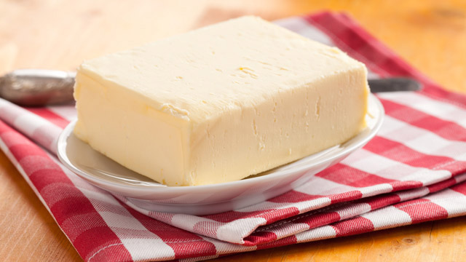
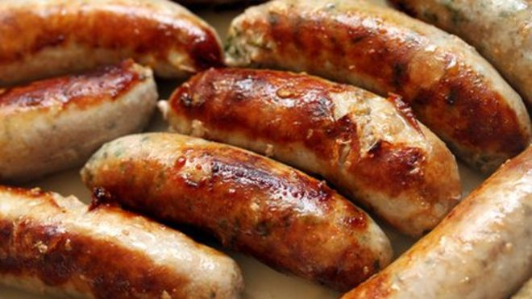
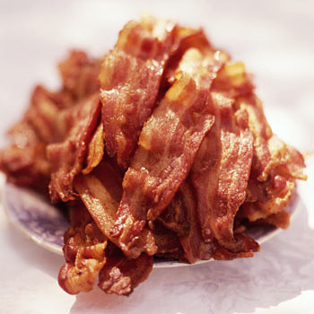
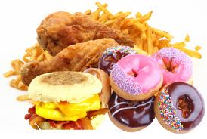
What about fats?
Fats are found in both animal products and plants. Animal fats include those in meat and dairy foods like cheese, milk, butter and ice cream. These fats should only be eaten in small quantities, as too much can lead to weight gain, heart disease and other health problems.
Fat is a high energy food. If we eat more than we need, our body stores it.
Many treat foods are fried in fat, so eating them often can mean you put on weight.

Slide 10
Let’s recap on what we know
Which foods are packed with vitamins that help us fight germs and stay healthy?
Which foods help our bodies to repair themselves after an injury and help muscles to grow?
These foods are rich in …
Protein
Which foods give us steady energy and keep us feeling full?
These foods are called …
Carbohydrates

Slide 11
Which foods contain calcium to give us strong bones and teeth?
This group is called …
Which group of foods can cause health problems like weight gain, diabetes and heart disease if we eat too much?
Dairy foods
This group is called …
Sugars and fats

Slide 12
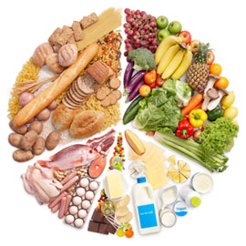
What is a balanced diet?
Carbohydrates
Fruit and Vegetables
Imagine everything you eat divided into 3 equal groups
One third should be carbohydrates
One third should be fruit and vegetables
One third should be proteins, dairy, fats and sugars combined
Proteins
Dairy
Sugars and fats should be a very small proportion of a balanced diet
Sugars
And fats

Slide 13
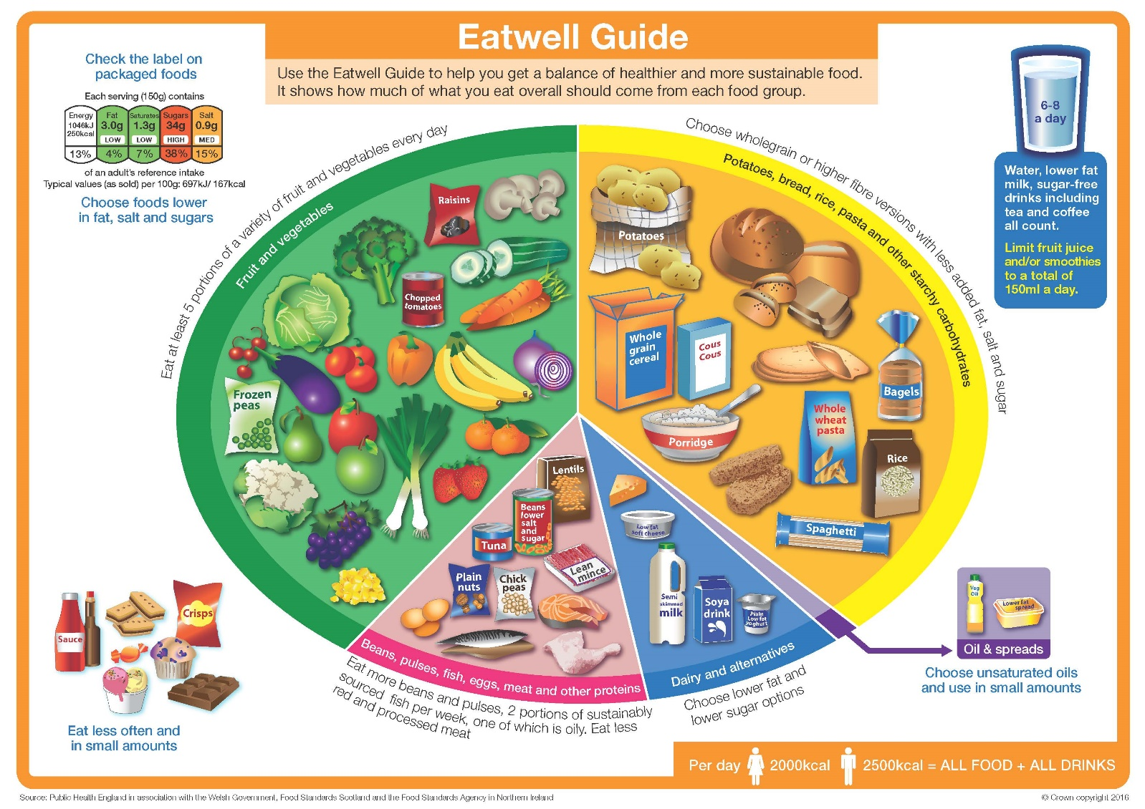
The Eatwell Plate
This is a simple idea to help us know what proportion of each group of foods we should eat to stay healthy.
It is called The Eatwell Plate.
It would be good for each team of researchers to create an Eatwell Plate for their client.
You will be able to use it to teach your client the importance of eating a healthy, balanced diet.

