Slide 1
Science - Year 3
Animals incl. Humans – Block 3AH
Keeping Healthy
Session 4
PowerPoint
© Original resource copyright Hamilton Trust, who give permission for it to be adapted as wished by individual users.
We refer you to our warning, at the foot of the block overview, about links to other websites.

Slide 2
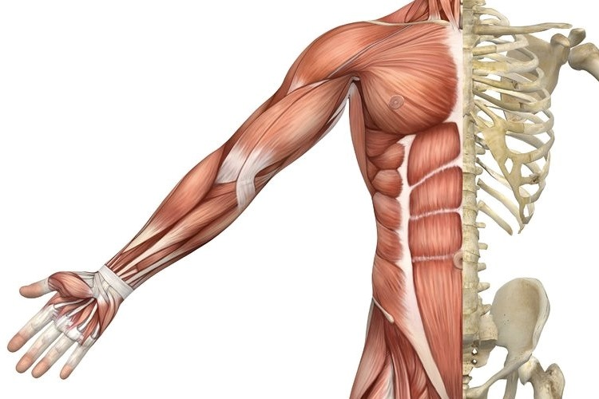
How many muscles do you have in your body?
Over 600!

Slide 3
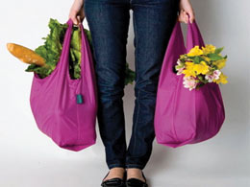
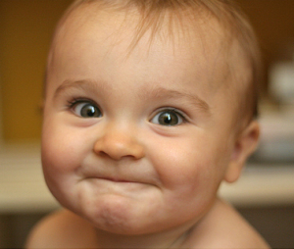
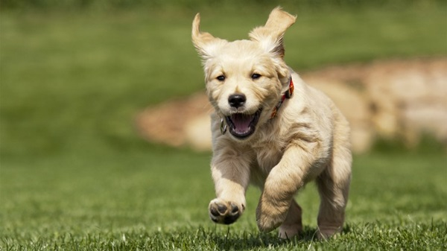
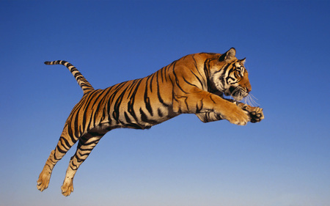
Muscles are responsible for every movement an animal makes.
Lifting heavy things
Smiling
Running
Jumping
Even breathing!

Slide 4
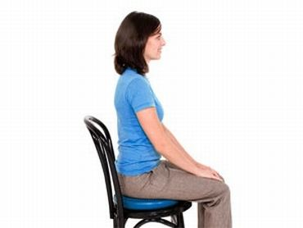
Muscles are also responsible for holding your posture (your body’s position when you are sitting or standing).
Good posture when sitting or standing is a nice straight back with your tummy pulled in.

Slide 5
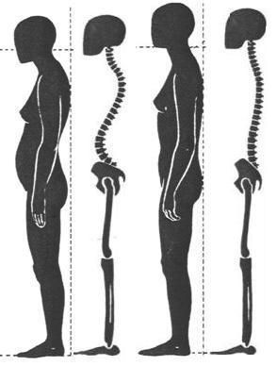
Most children have a naturally good posture but as people get older, their posture can become a problem, leading to backache and neck pain.
This one
Notice the straighter spine, the head up and the tummy pulled in.
Working to strengthen your posture muscles and improving the way you sit or stand can really help with back ache and neck problems.
Which person has the better posture?

Slide 6
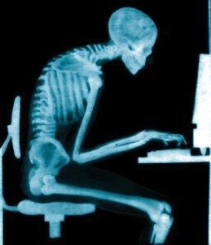
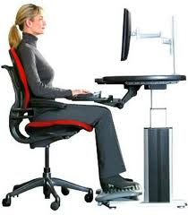
Everyday tasks like driving a car and working at a computer can lead to bad posture, muscle pain and even headaches.
A chair with more back support and a screen at the right height can really help.
Stand up and check on your posture with a partner. Remember straight back, head up, tummy in!

Slide 7
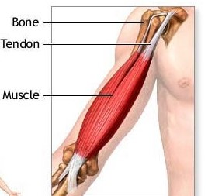
Muscles are made of strong stretchy tissue that can contract and relax
Tendons attach muscles to bones.
What are these muscles called?
The biceps and triceps

Slide 8
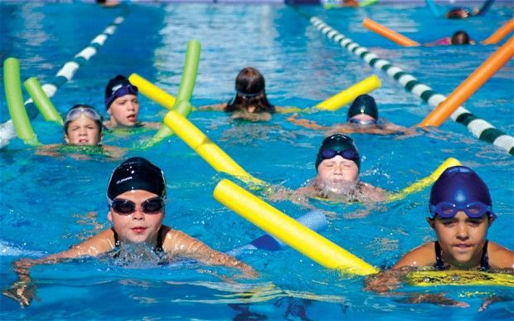
When you exercise or train in a sport you often use the same muscles again and again which can make them ache after a while. You may have felt this beginning to happen when you did the water bottle exercise!

Slide 9
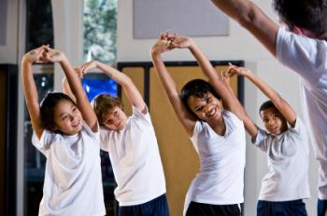
Muscles need to be warmed up before exercise with gentle stretches. This prepares the muscles for activity and prevents injury to muscles and joints.
Do you always warm up before exercise?

